Slide 1
Data Structures & Algorithms (CSC-214)
Linked List

Slide 2
Roadmap
List as an ADT
An array-based implementation of lists
Introduction to linked lists
A pointer-based implementation in C++
Variations of linked lists

Slide 3
Linked List – Advantages
Access any item as long as external link to first item maintained
Insert new item without shifting
Delete existing item without shifting
Can expand/contract (flexible) as necessary

Slide 4
Linked List – Disadvantages (1)
Overhead of links
Used only internally, pure overhead
If dynamic, must provide
Destructor
Copy constructor
Assignment operator
No longer have direct access to each element of the list
Many sorting algorithms need direct access
Binary search needs direct access
Access of nth item now less efficient
Must go through first element, then second, and then third, etc

Slide 5
Linked List – Disadvantages (2)
List-processing algorithms that require fast access to each element cannot be done as efficiently with linked lists
Consider adding an element at the end of the list
Array | Linked List
a [size++] = value;

Slide 6
Linked List – Disadvantages (2)
List-processing algorithms that require fast access to each element cannot be done as efficiently with linked lists
Consider adding an element at the end of the list
Array | Linked List
a [size++] = value; | Node* NewNode = new Node; NewNode -> data = x; NewNode -> nullptr;

Slide 7
Linked List – Disadvantages (2)
List-processing algorithms that require fast access to each element cannot be done as efficiently with linked lists
Consider adding an element at the end of the list
Array | Linked List
a [size++] = value; | Node* NewNode = new Node; NewNode -> data = x; NewNode -> nullptr; if(head == NULL) head = NewNode;

Slide 8
Linked List – Disadvantages (2)
List-processing algorithms that require fast access to each element cannot be done as efficiently with linked lists
Consider adding an element at the end of the list
Array | Linked List
a [size++] = value; | Node* NewNode = new Node; NewNode -> data = x; NewNode -> nullptr; if(head == NULL) head = NewNode; else int i = 1; Node* ptr = head; while(ptr) //iterate over the list till you find the end
This is the inefficient part

Slide 9
Doubly Linked List

Slide 10
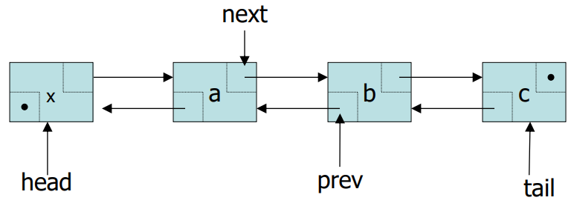
Doubly Linked List
Every node contains the address of the previous node except the first node
Both forward and backward traversal of the list is possible

Slide 11
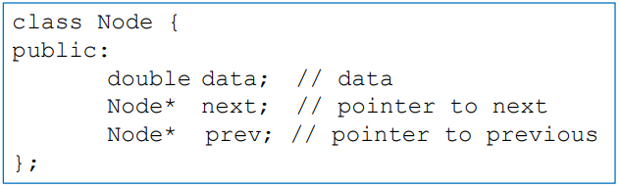
Node Class
Node class contains three data members
data: double-type data in this example
next: a pointer to the next node in the list
prev: a pointer to the pervious node in the list

Slide 12
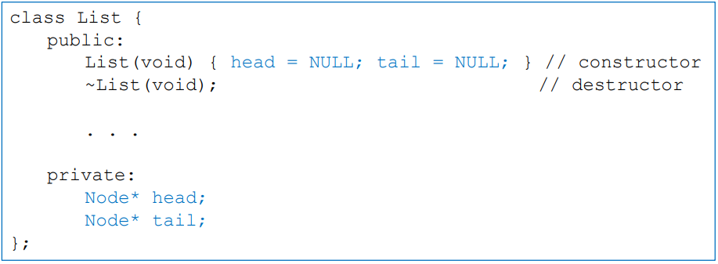
List Class
List class contains two pointers
head: a pointer to the first node in the list
tail: a pointer to the last node in the list
Since the list is empty initially, head and tail are set to NULL

Slide 13
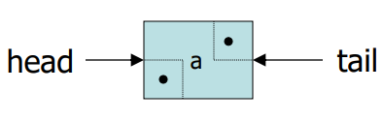
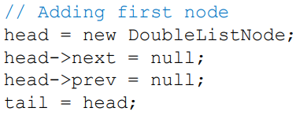
Adding First Node

Slide 14
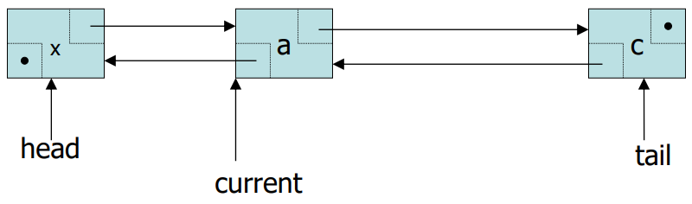
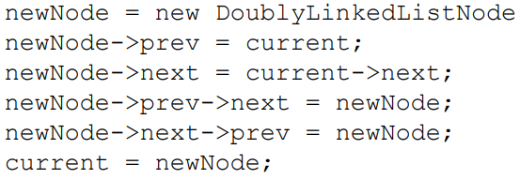
Inserting a Node in Doubly Linked List (1)
To add a new item after the linked list node pointed by current

Slide 15
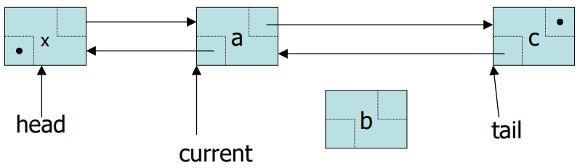
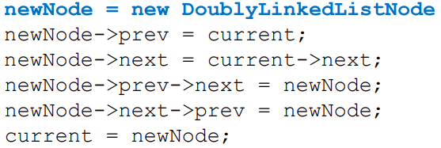
Inserting a Node in Doubly Linked List (2)
To add a new item after the linked list node pointed by current

Slide 16
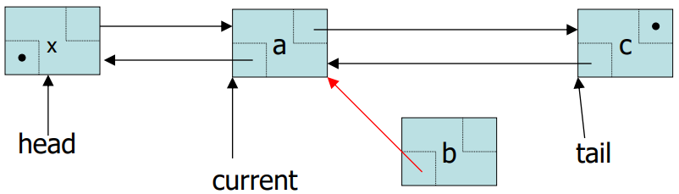
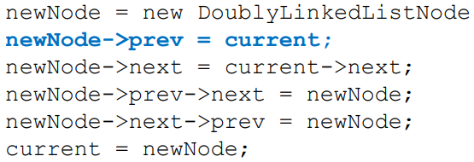
Inserting a Node in Doubly Linked List (3)
To add a new item after the linked list node pointed by current

Slide 17
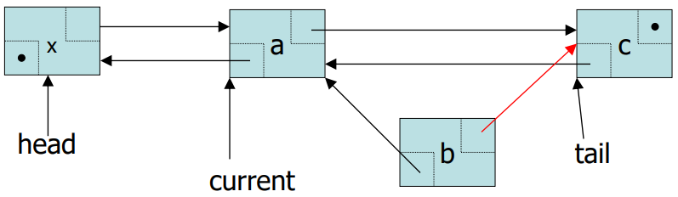
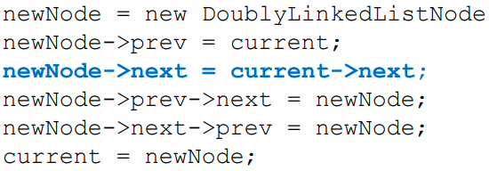
Inserting a Node in Doubly Linked List (4)
To add a new item after the linked list node pointed by current

Slide 18
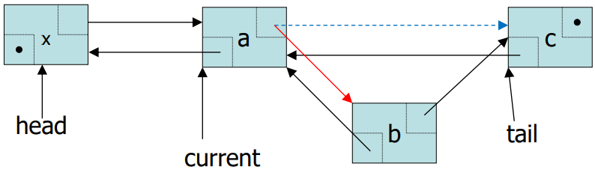
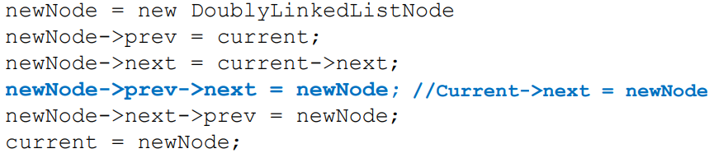
Inserting a Node in Doubly Linked List (5)
To add a new item after the linked list node pointed by current

Slide 19
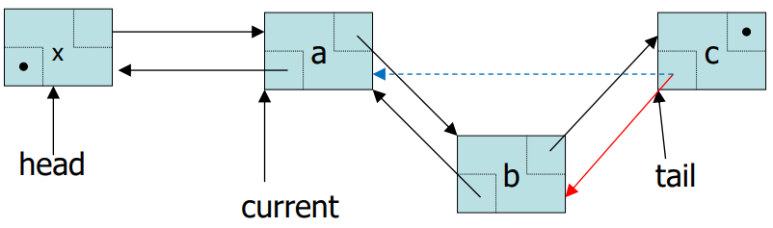
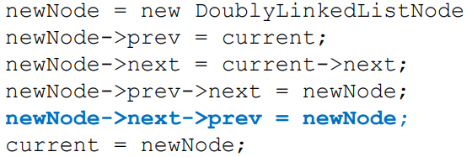
Inserting a Node in Doubly Linked List (6)
To add a new item after the linked list node pointed by current

Slide 20
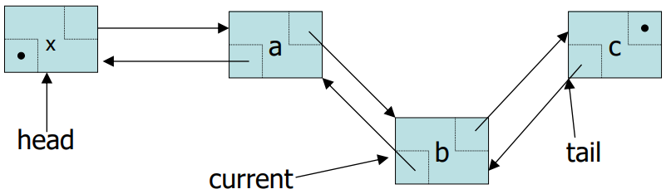
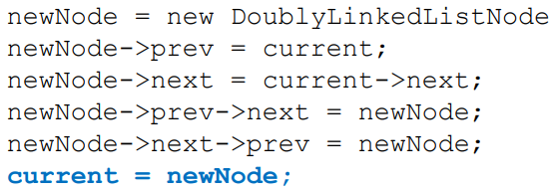
Inserting a Node in Doubly Linked List (7)
To add a new item after the linked list node pointed by current

Slide 21
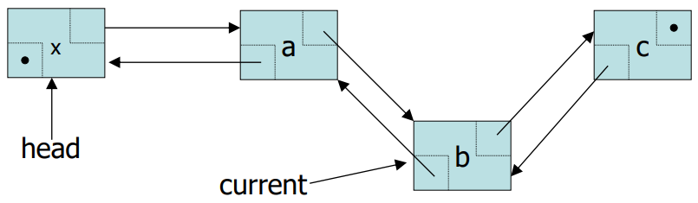
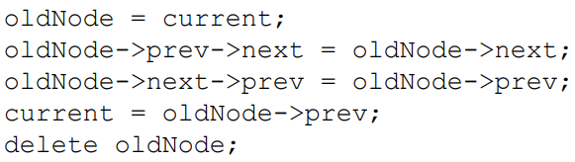
Deleting a Node From Doubly Linked List (1)
Suppose current points to the node to be deleted from the list

Slide 22
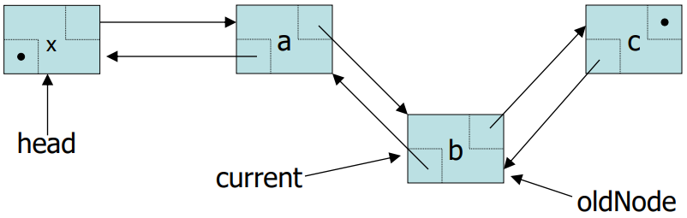
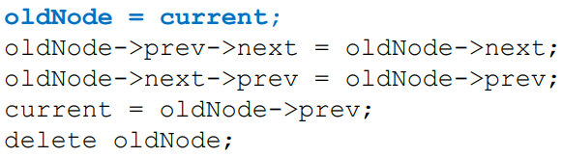
Deleting a Node From Doubly Linked List (2)
Suppose current points to the node to be deleted from the list

Slide 23
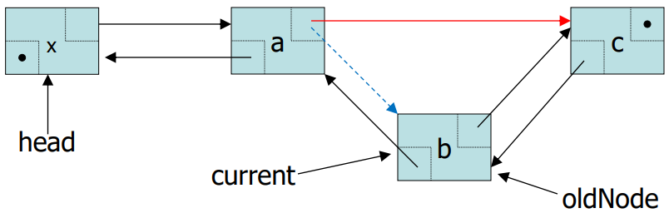
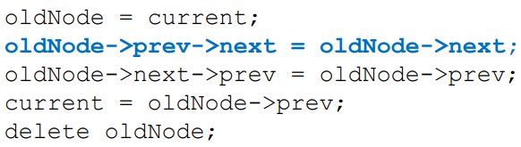
Deleting a Node From Doubly Linked List (3)
Suppose current points to the node to be deleted from the list

Slide 24
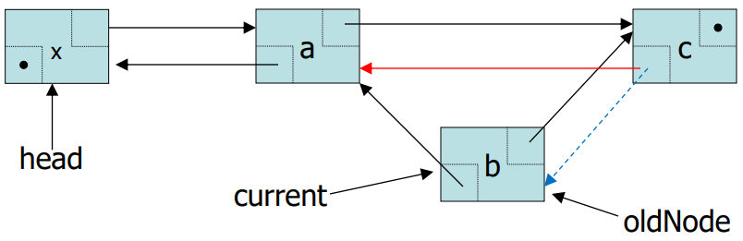
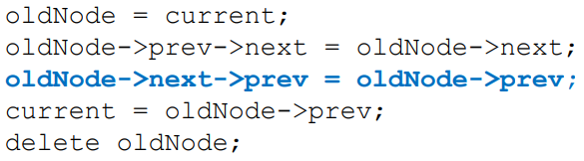
Deleting a Node From Doubly Linked List (4)
Suppose current points to the node to be deleted from the list

Slide 25
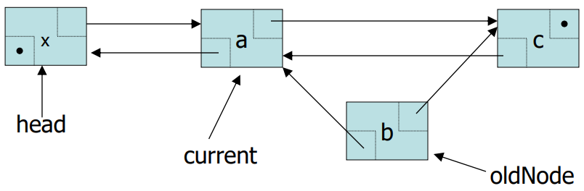
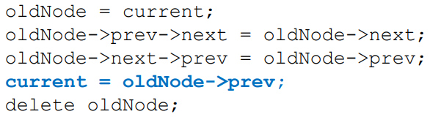
Deleting a Node From Doubly Linked List (5)
Suppose current points to the node to be deleted from the list

Slide 26
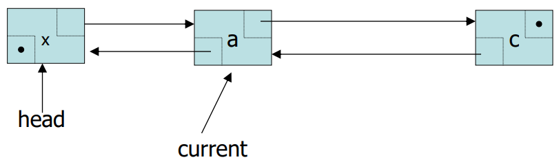
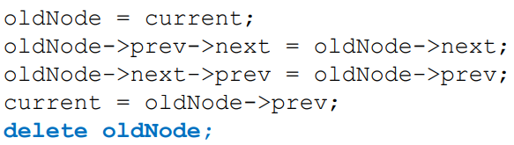
Deleting a Node From Doubly Linked List (6)
Suppose current points to the node to be deleted from the list

Slide 27
Some Applications
Applications that maintain a Most Recently Used (MRU) list
For example, a linked list of file names
Cache in the browser that allows to hit the BACK button
A linked list of URLs
Undo functionality in Photoshop or Word
A linked list of state
A list in the GPS of the turns along your route
Can we traverse the linked list in the reverse direction?

Slide 28
At home practice
Create copy constructor and destructor yourself (very similar to singly linked list implementation)
Create a function to reverse the doubly linked list (you have to reverse the data values, not the actual nodes themselves)
Write the driver program yourself (Check all edge cases as well)
Basic code will be shared

Slide 29
Doubly linked lists advanced operations
Reverse the links in the list
Sort the list (e.g., using Bubble Sort)
Merge two doubly linked lists
void Merge(List& other1, List& other2); //easy implementation
void Merge(List& other); //tricky implementation
Remove duplicates

Slide 30
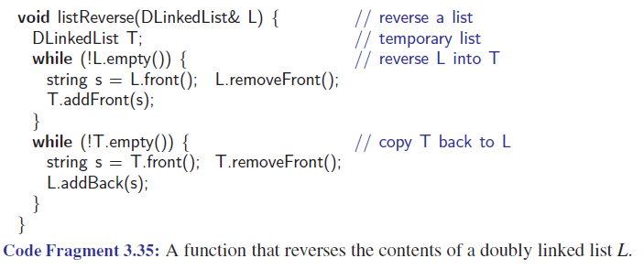
Reversing a Doubly Linked List

Slide 31
Circular Linked List

Slide 32
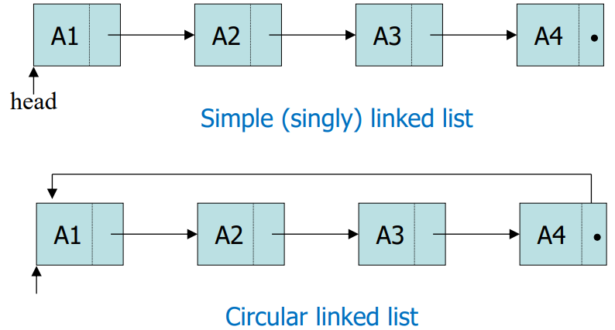
Circular Linked List
A linked list in which the last node points to the first node

Slide 33
Advantages of Circular Linked List
Whole list can be traversed by starting from any point
Any node can be starting point
What is the stopping condition?
Fewer special cases to consider during implementation
All nodes have a node before and after it (unlike head and tail in Singly and Doubly Linked Lists)
Used in the implementation of other data structures
Circular queues and priority queues (will study them later)

Slide 34
Disadvantages of Circular Linked List
Finding end of list and loop control is harder
No NULLs to mark beginning and end

Slide 35
Circular Linked List Operations
Insertion
at the beginning/end
Deletion
From the beginning/end
Traversal
Start from any node and keep moving forward until you encounter the starting node again
Searching: traverse the list while checking if the target value exists in any node
Counting nodes: start from a node and traverse until you return to the starting node, maintaining a counter.
Destructor
Copy Constructor
Operator overloading

Slide 36
Other operations
Splitting: split into two smaller circular linked lists based on even/odd positions or some midpoint.
Create two new lists (can alter the original list by emptying it OR keep the original list as it is)
Append required nodes to a new list and keep remaining in the original list (will change the original list)
Merging: two circular linked lists can be merged into a single circular linked list by updating their last nodes.
Reversal: reverse the pointers of the list so that the last node becomes the first and vice versa.

Slide 37
Any Questions?

